Slide 1

Cadence

Slide 2
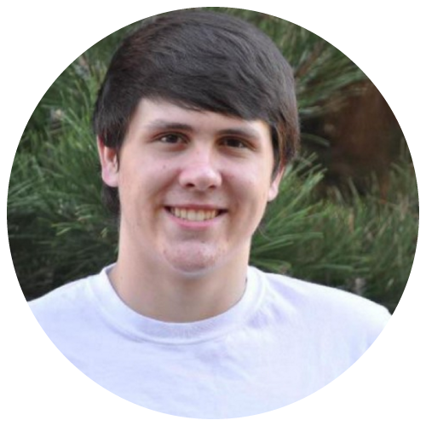
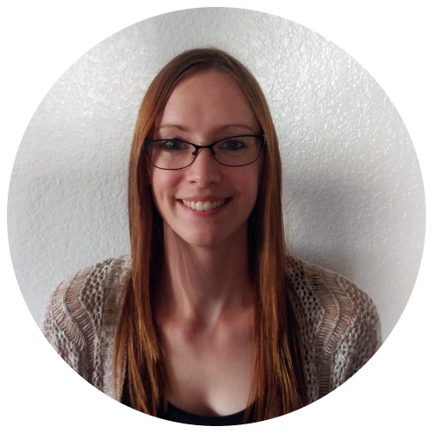
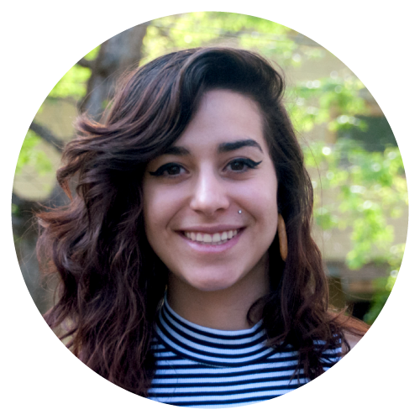

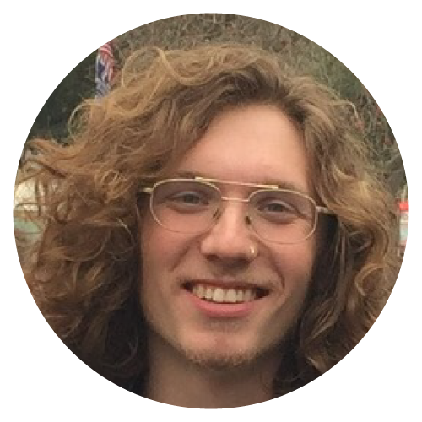
Our Team
Spencer Hanson
Jessie Albarian
Sophie Brande
Carly Romig
Evan James
Notes:
Everyone

Slide 3
What is Cadence?
Cadence is a web application that provides personalized Spotify playlists on demand. Our purpose is to eliminate the weekly anticipation for a Discover Weekly playlists allowing users a simple outlet to discover music as often as they like. Now listening to countless playlists to find some new song when you hate your music is a thing of the past.
You're welcome.
Notes:
SOPHIE

Slide 4
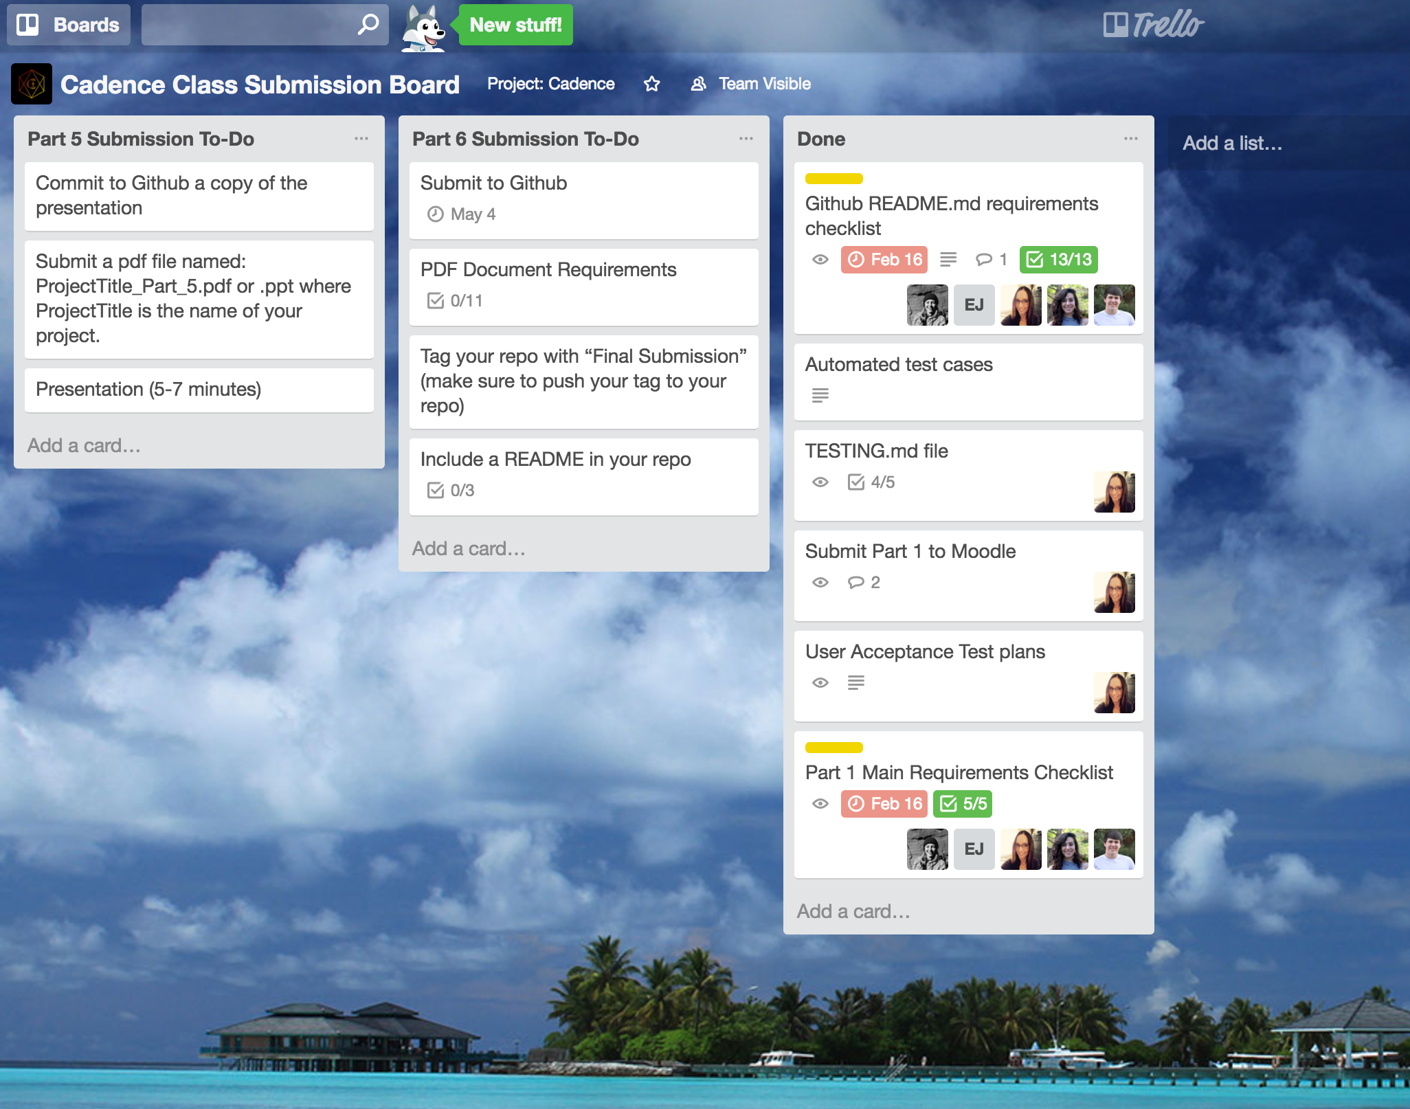
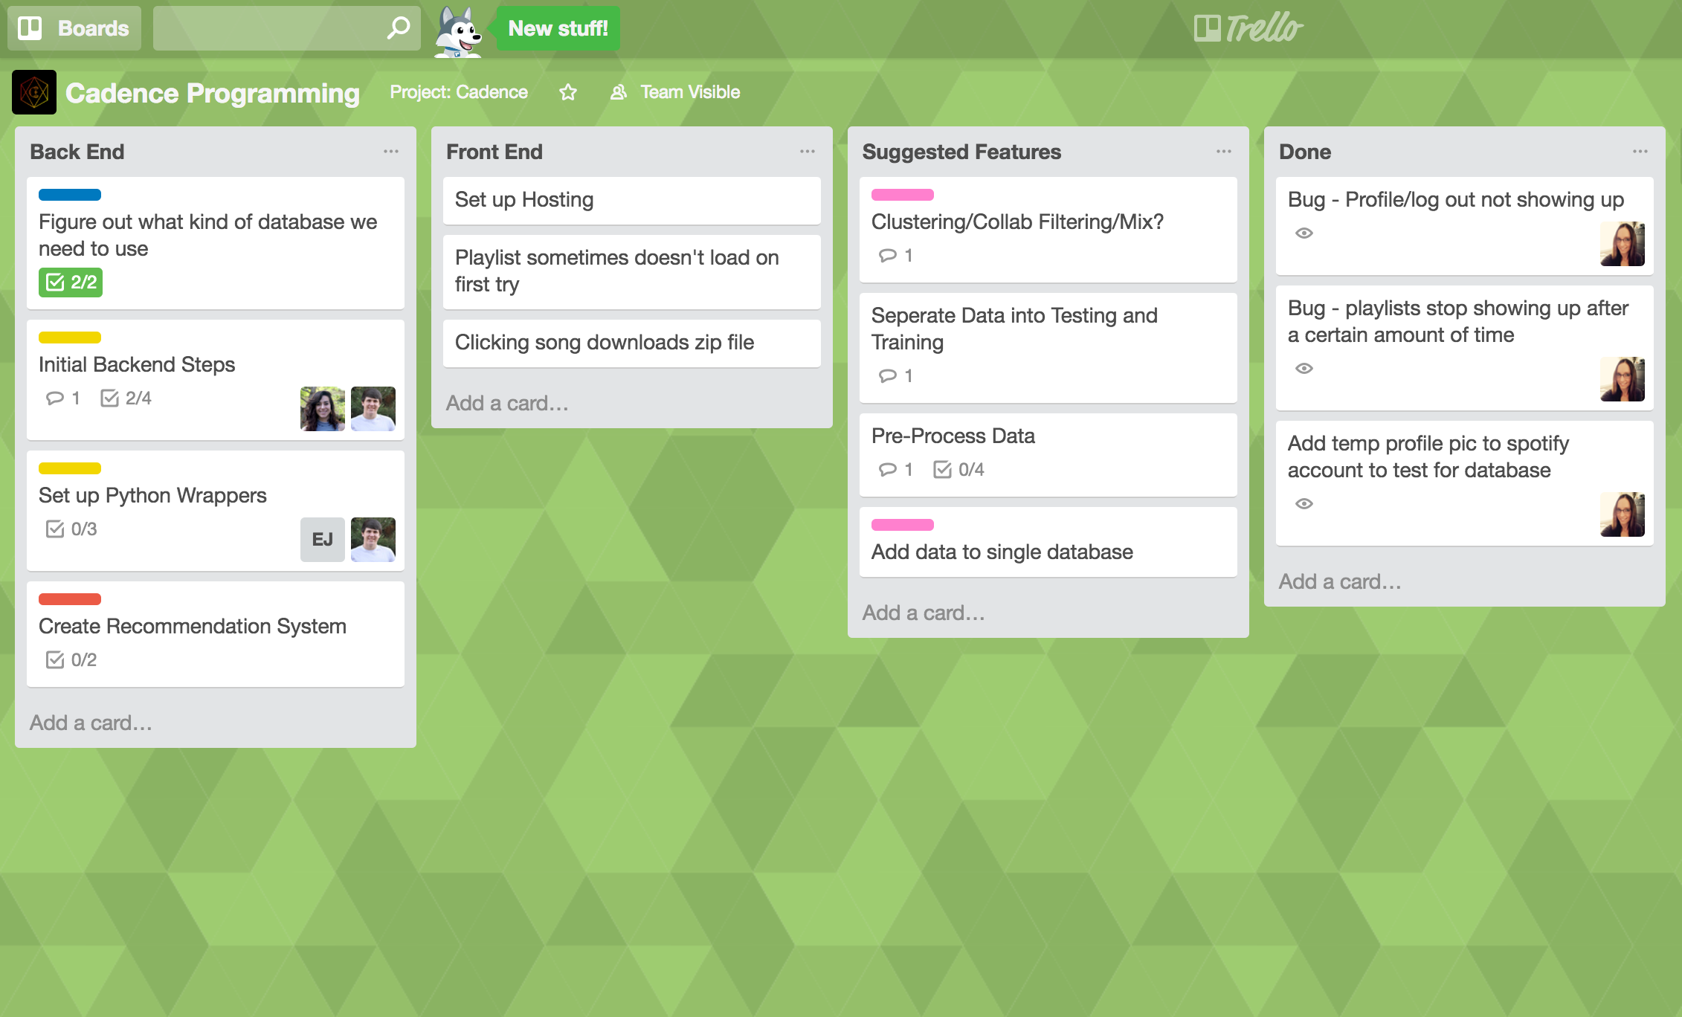
Project Tracking Software: Trello
Rating: 4.5/5
Notes:
SOPHIE
We gave Trello a 4.5/5 because it’s a really straightfoward application. It’s a really simple way to keep in contact with your team and let each other know how far you are on your task - but we ended up not using it very much so we gave it a lower rating.

Slide 5
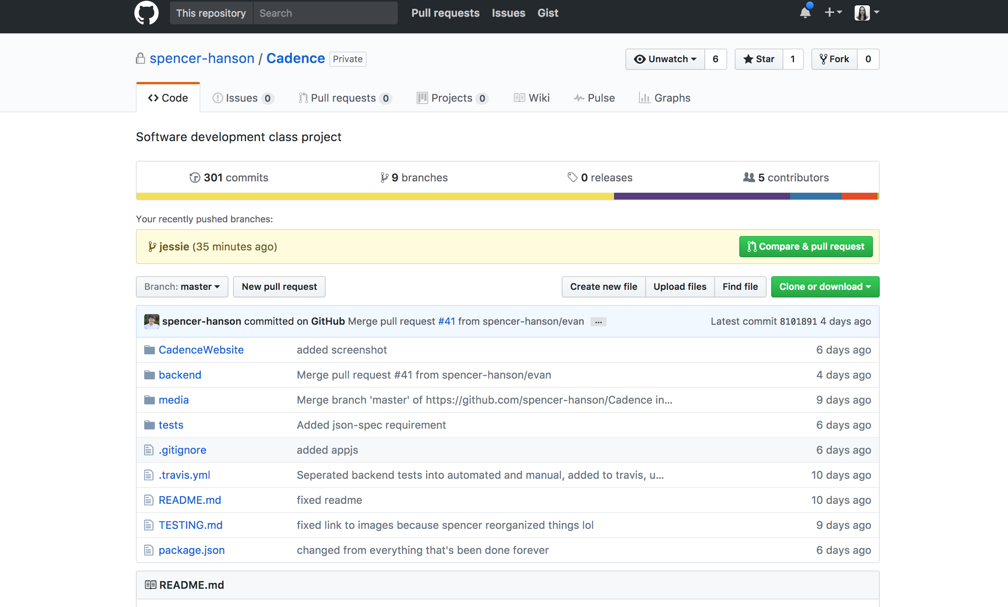
VCS: Github
Rating: 5/5
Notes:
JESSIE: We used Github for our version control system, we gave it a 5/5 because it worked great for us.
Everyone had a different branch to work on and we all pushed to master after code reviews

Slide 6

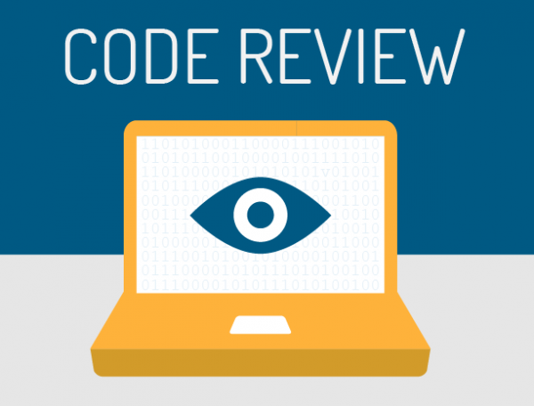
Methodologies: Pair Programming & Code Reviews
Notes:
JESSIE: We did a lot of pair programming and we created our github account in way that made it so we had to do reviews on pull requests before branches were merged to master

Slide 7
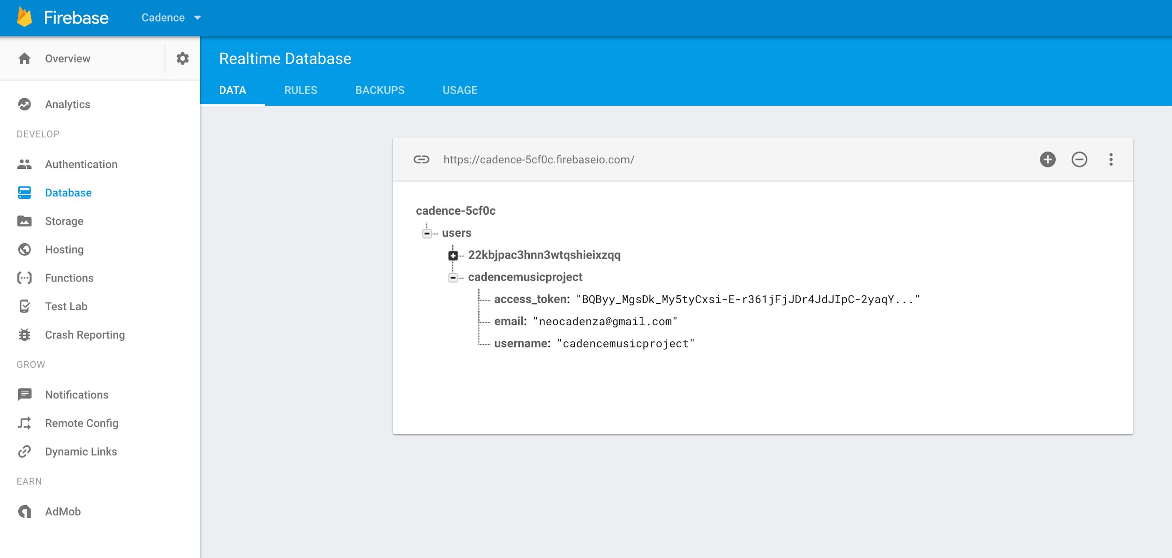
Databases: Firebase
Rating: 4.5/5
Notes:
JESSIE: We used Firebase as our database to store Spotify user data. We gave it a 4.5 out of 5 because it was really easy to use; however, documentation for it isn’t great

Slide 8
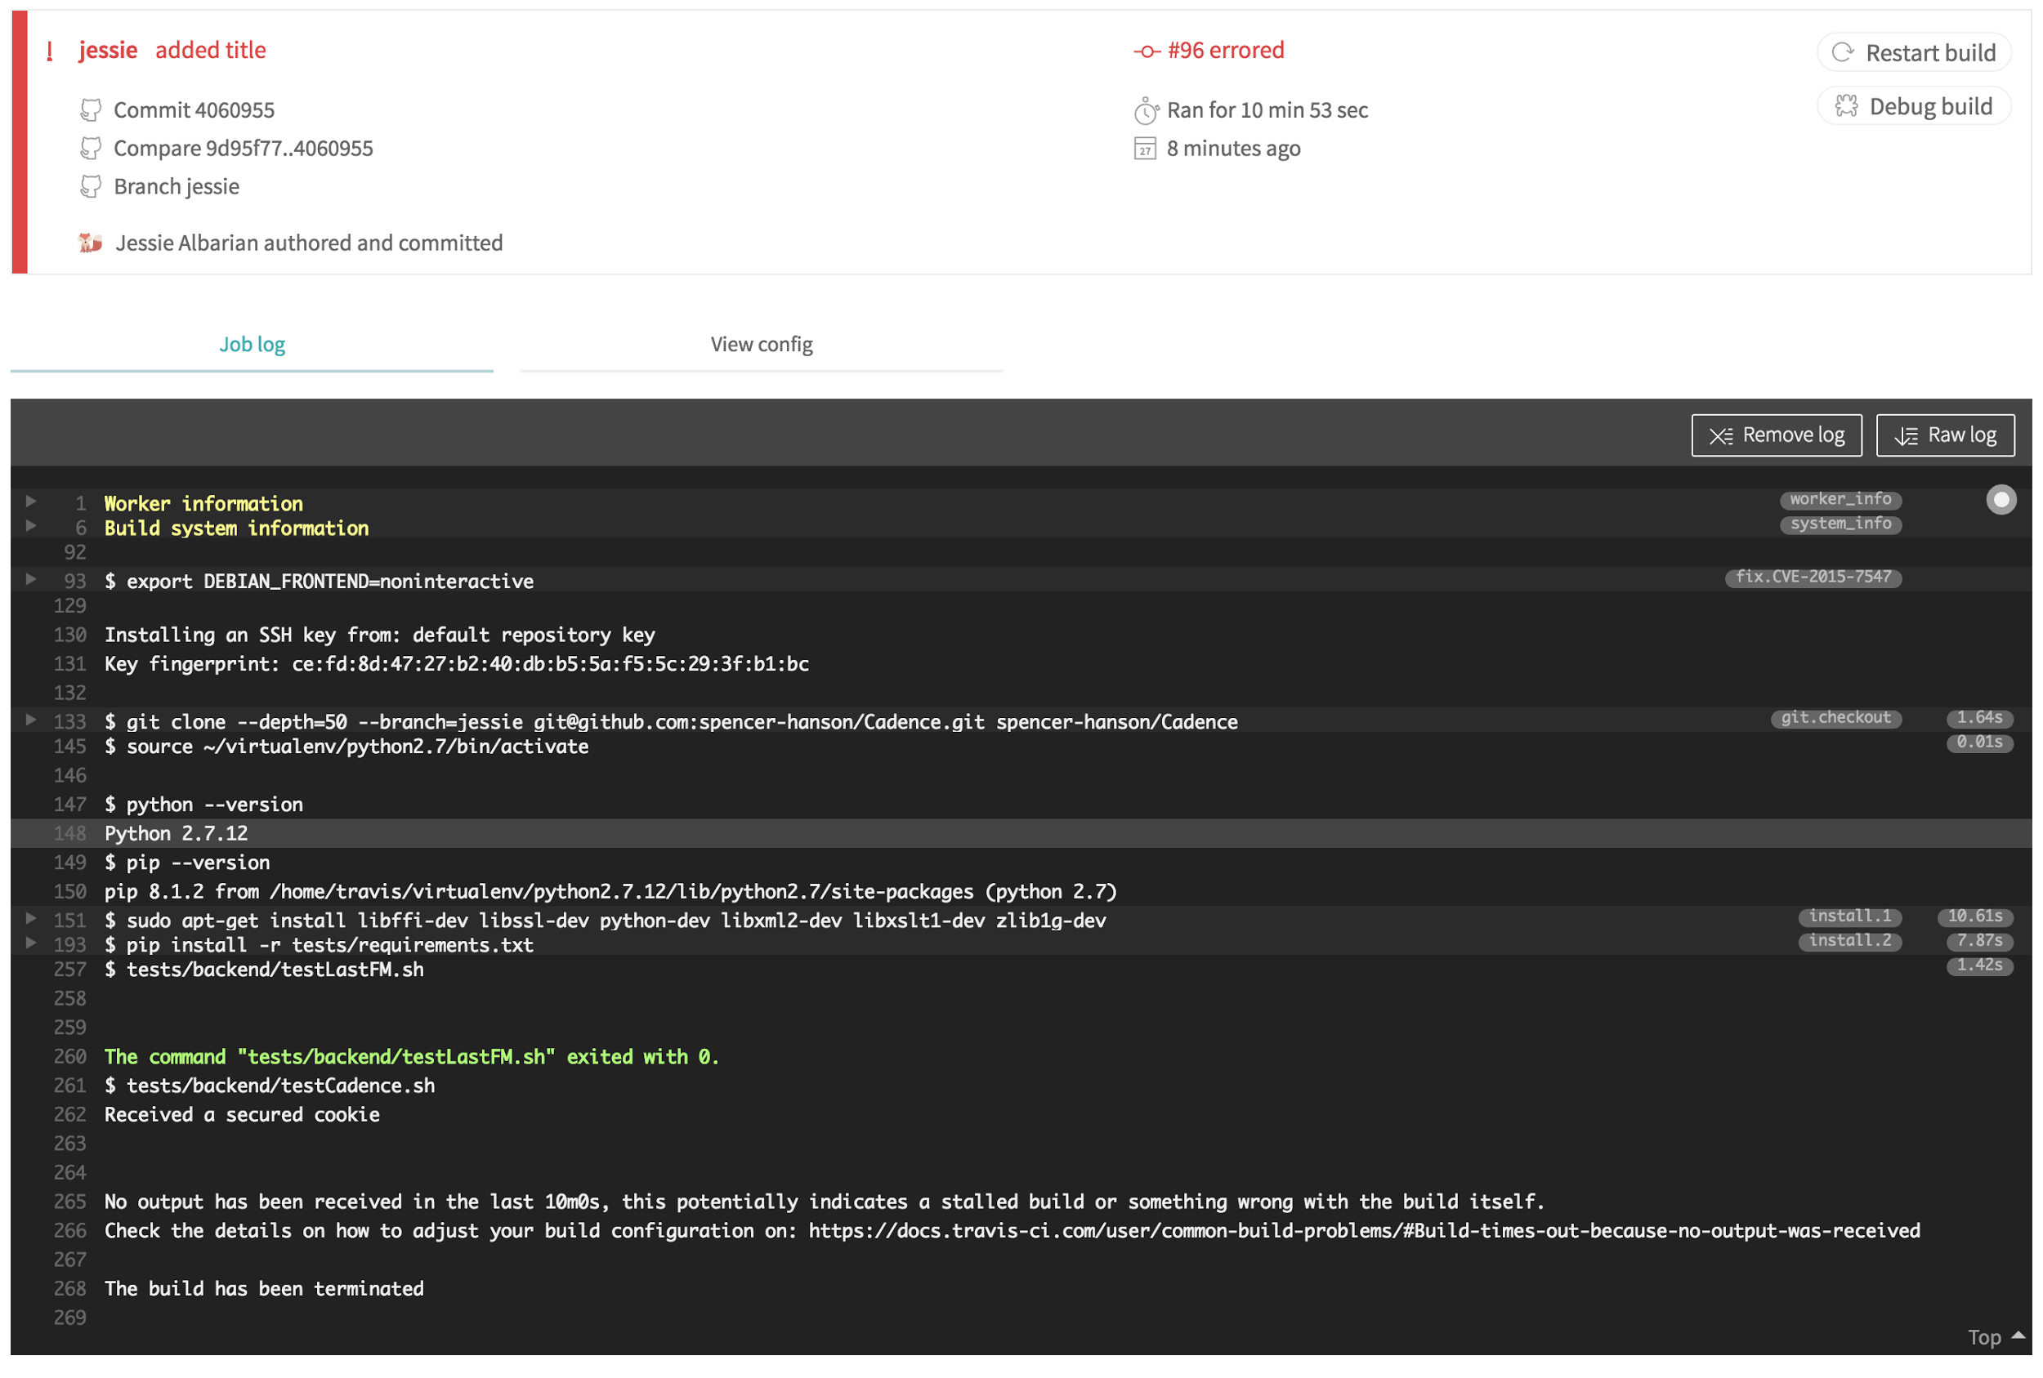

Testing: Travis-CI
Rating: 3/5
Notes:
EVAN

Slide 9

Auto-Documenter: PyDoc
Rating: 4/5
Notes:
EVAN

Slide 10

Deployment Environment: Linode
Rating: 5/5
Notes:
Carly-->We used Linode for our deployment environment, we really liked it because it’s easy to use which is why we gave it a 5/5

Slide 11
What Technologies/Languages Did We Use?
Frontend
HTML/CSS
SASS
LESS
Javascript
NodeJS
Bootstrap framework
Spotify API
Firebase database
Backend
Python
Node
Javascript
Cassandra
Spotify API
Last FM
Flask
Beautiful Soup
Notes:
Carly-->

Slide 12
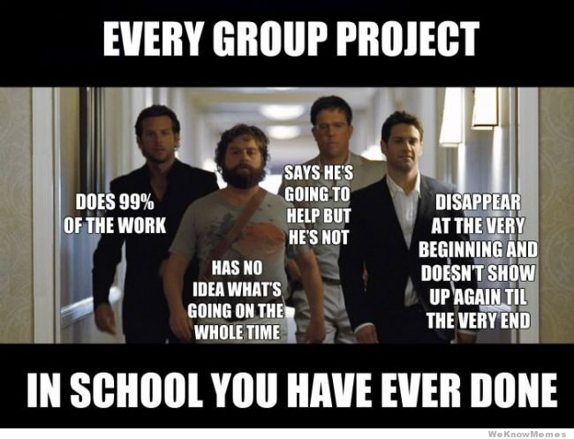
Challenges
Notes:
SPENCER: Some of us didn’t know the languages we were working with, we didn’t know each other or how each other worked. We got a lot of our project done at T9Hacks, one of the hackathons at CU Boulder, but we definitely changed our minds on how we were doing the project several times.

Slide 13
Demo
Notes:
SPENCER

Slide 14
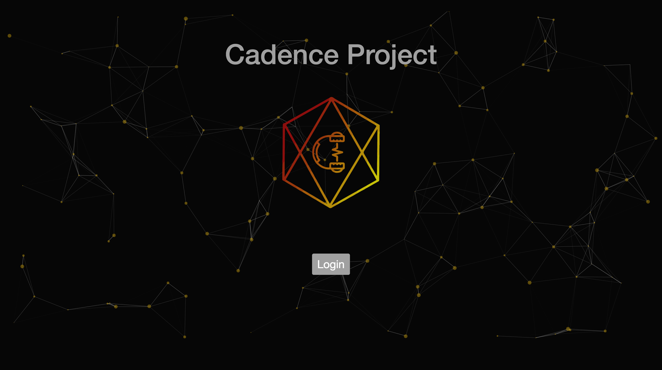

Slide 15
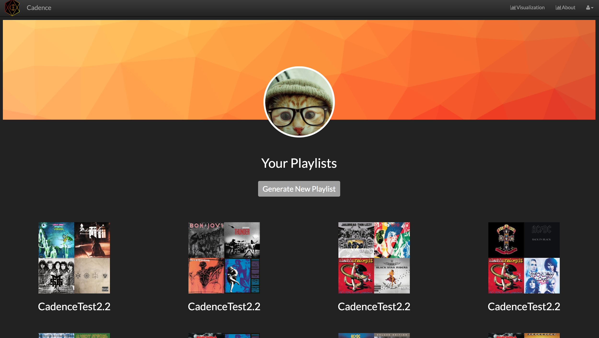

Slide 16
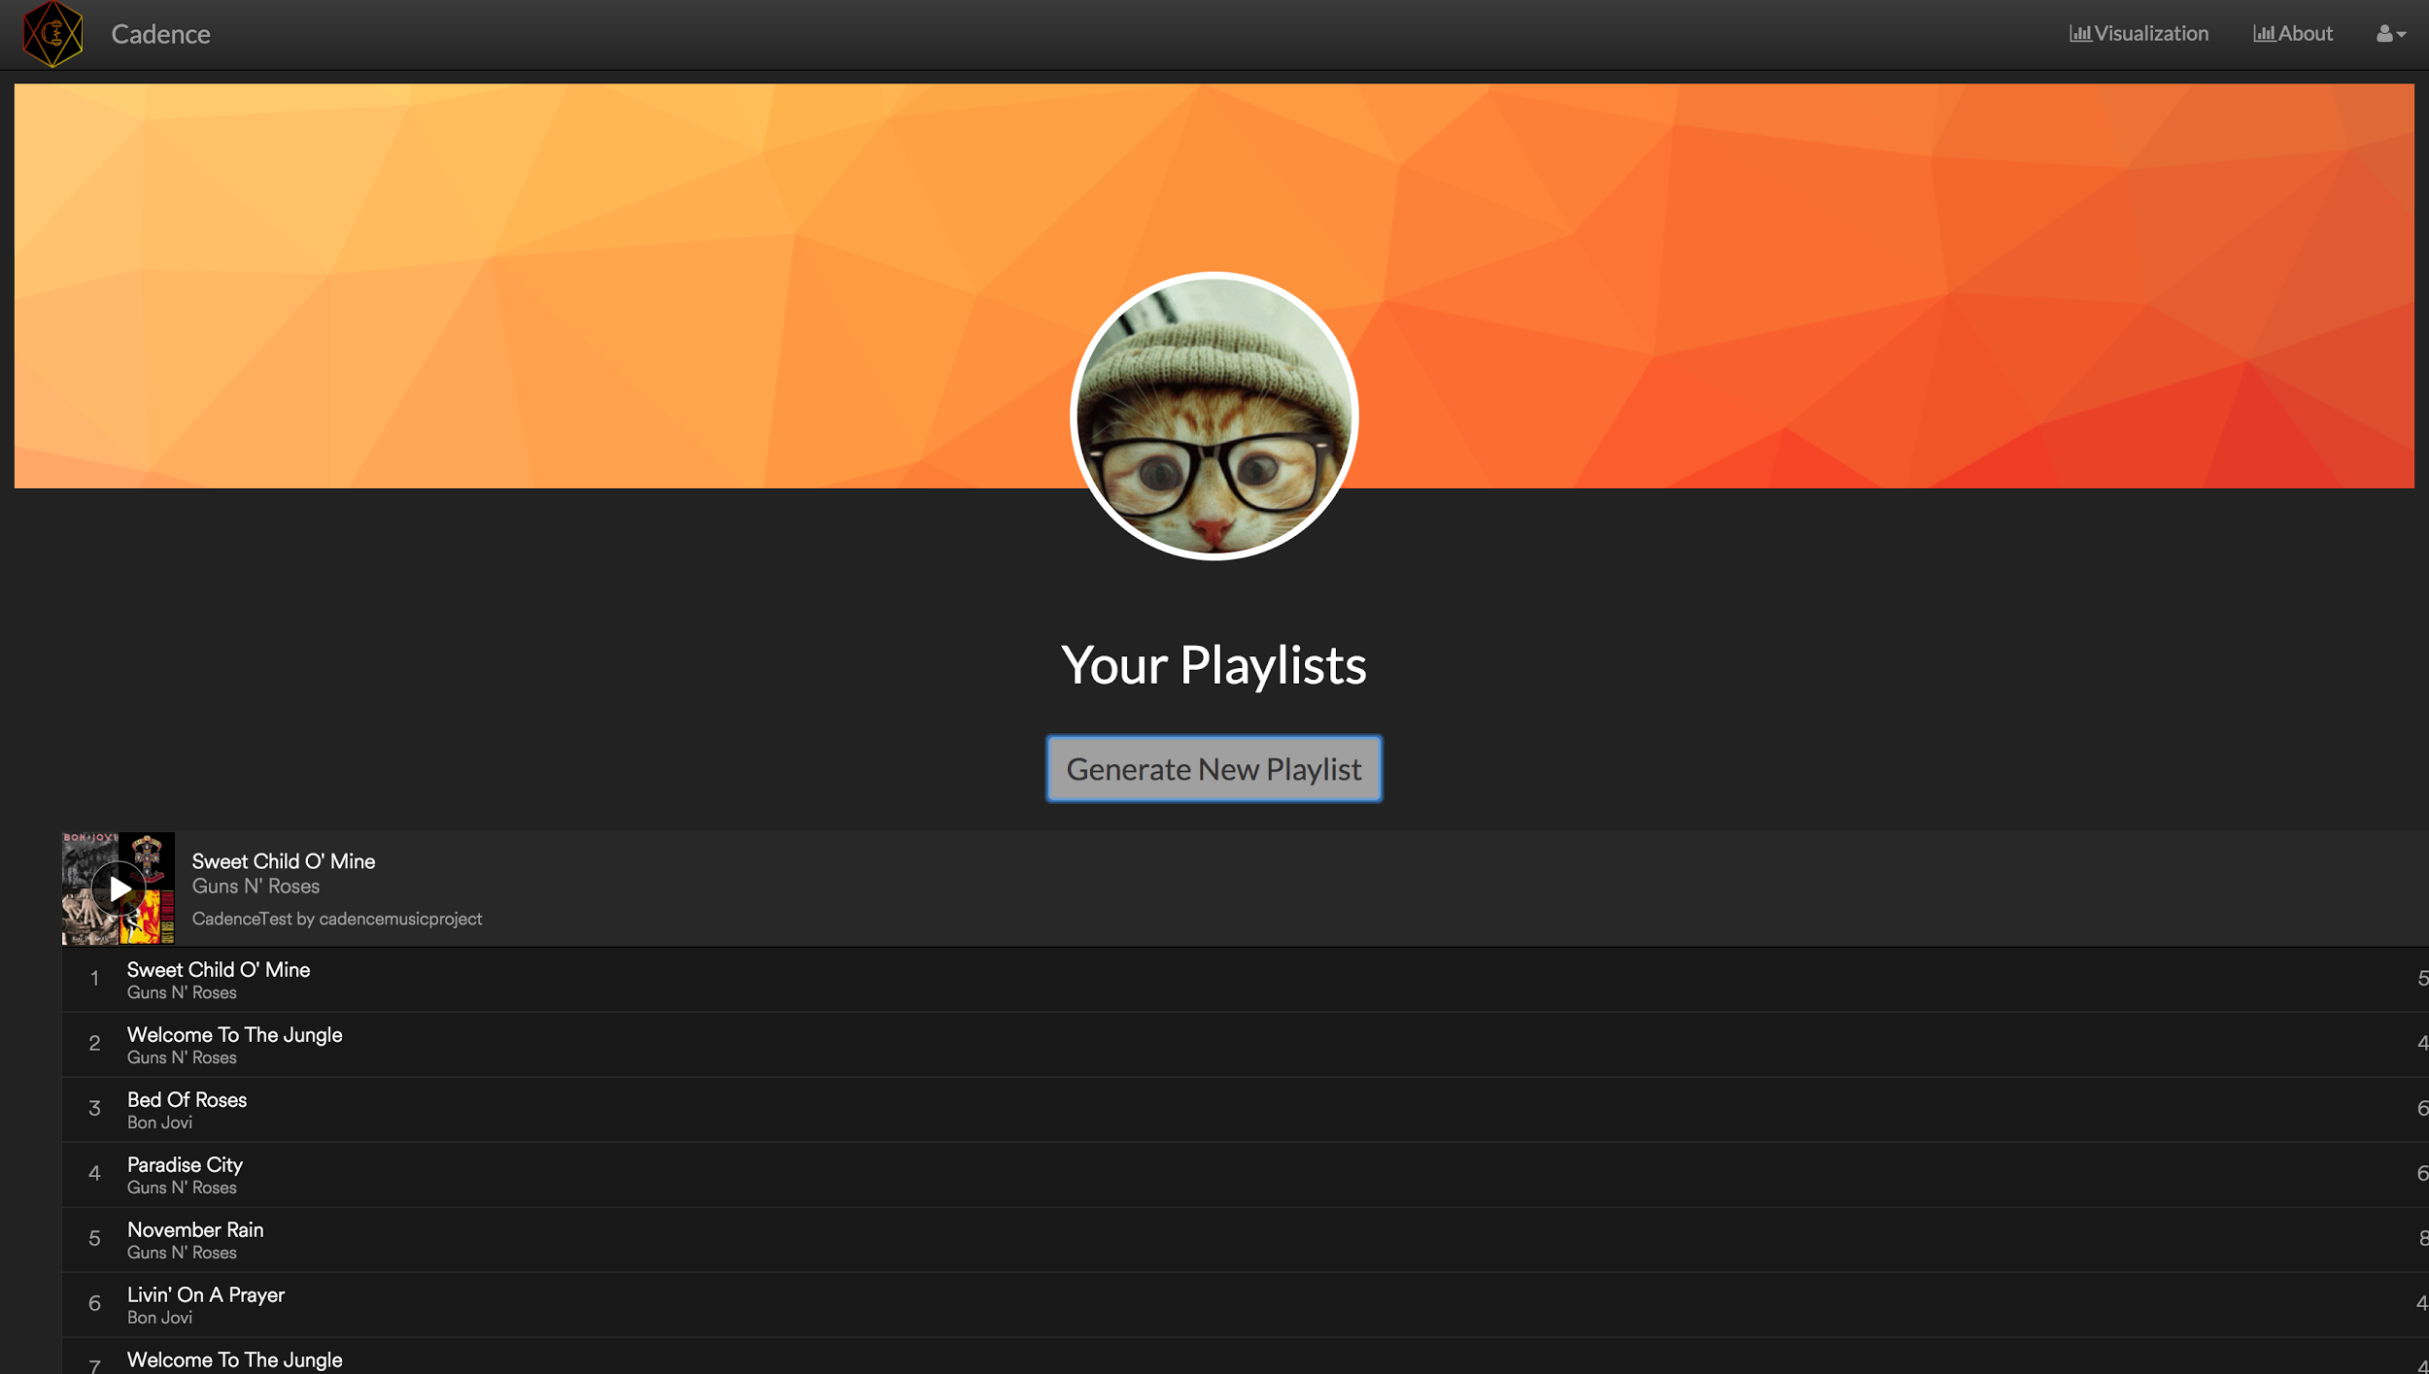

Slide 17
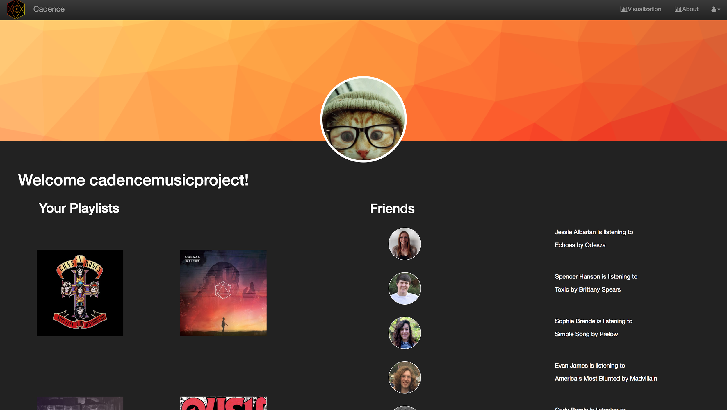

Slide 18
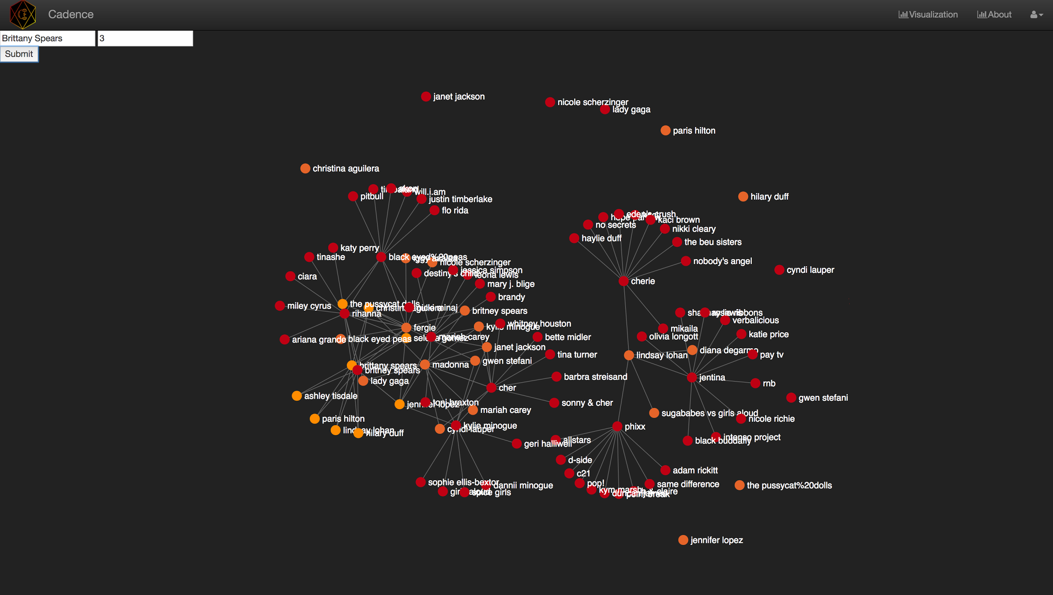

Slide 19
